Slide 1
Surveys and Tests have questions.
Only Tests have correct answers.
Should you have a single class for both correct answers and responses or have separate classes?
One class to handle both a response and correct answer
Two classes, one for response and one for correct answer
CS 350 – Software Design – Drexel University

Slide 2

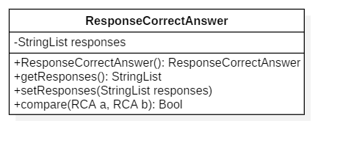
Having a single class to represent both a response and correct answer make sense.
They are each instances of the same data type.
When they are the same class they can be easily compared and should have a isequals method to simplify grading.
CS 350 – Software Design – Drexel University

Slide 3
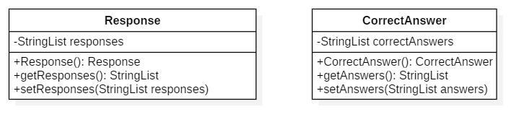
Separating the Response and CorrectAnswer into two classes sounds like a good idea, but a response and a correct answer are really different instances of the same class, not different classes.
When two integer variables are needed, you don’t think to create different classes, instead two instances of an integer class are instantiated.
Return to the previous question
CS 350 – Software Design – Drexel University

